Slide 1
Vocabulary List
The Book Name< Touching Spirit Bear>
David, Josh, Hail, Allen, Angela

Slide 2
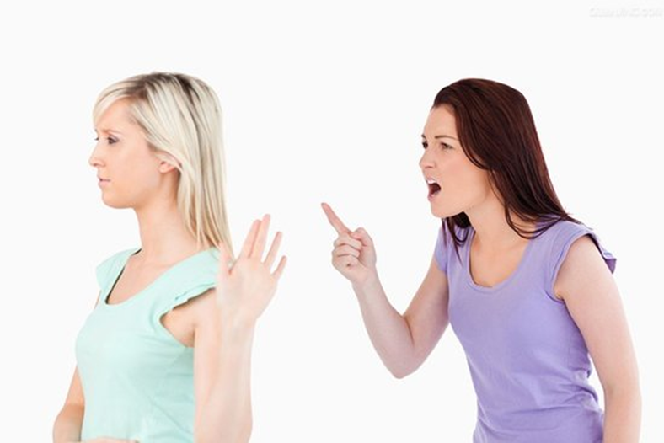
Word:___Ignore_________________ Book/Page Number (p87) | Write the sentence in the book where you found the word: He tried not to think about the end, but he could not ignore the maddening pain from his wound
Write the Definition of the word in your words (Do not copy from the dictionary) refuse to acknowledge
Words That Have the Same Meaning Neglect |  | Words That have the Opposite meaning pay attention to | Picture/Symbol of the Meaning:

Slide 3
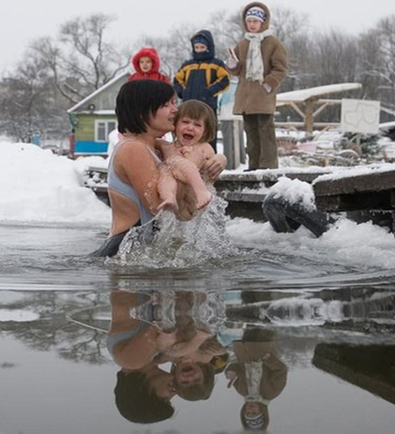
Word:______chill______________ Page Number (p87) | Write the sentence in the book where you found the word: As gusts of wind drove the chill deeper onto his body
Write the Definition of the word in your words (Do not copy from the dictionary) coldness due to a cold environment
Words That Have the Same Meaning cold. algor |  | Words That have the Opposite meaning warm | Picture/Symbol of the Meaning:

Slide 4
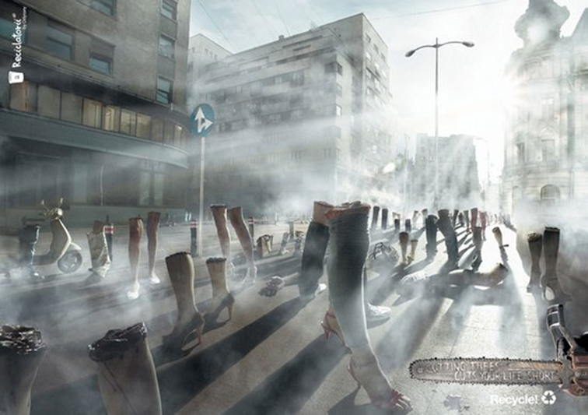
Word:_____consciousness_______________ Page Number (p87) | Write the sentence in the book where you found the word: Seeping into his consciousness, and flooding his soul.
Write the Definition of the word in your words (Do not copy from the dictionary) your mind and your thoughts
Words That Have the Same Meaning feel, aesthesia |  | Words That have the Opposite meaning | Picture/Symbol of the Meaning:

Slide 5
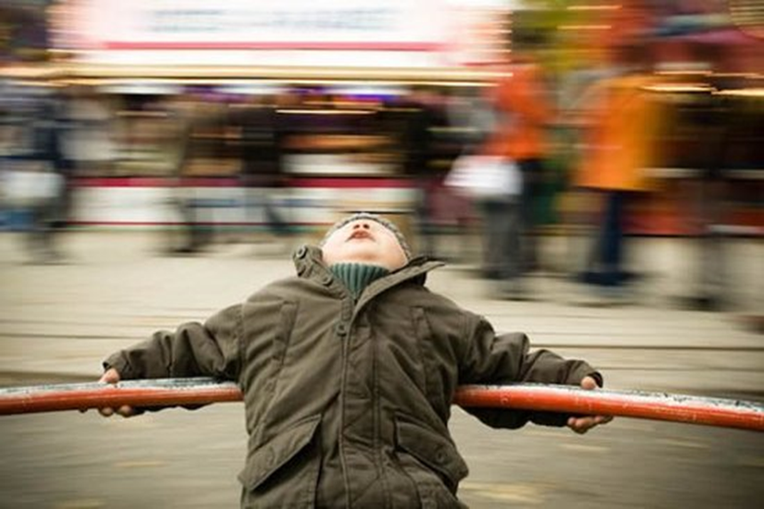
Word:__Faint__________________ Page Number (pg88) | Write the sentence in the book where you found the word: The visits brought faint chirping sounds.
Write the Definition of the word in your words (Do not copy from the dictionary) Can’t see hear clearly.
Words That Have the Same Meaning fuzzy, weak, dark, vague |  | Words That have the Opposite meaning clearly | Picture/Symbol of the Meaning:

Slide 6
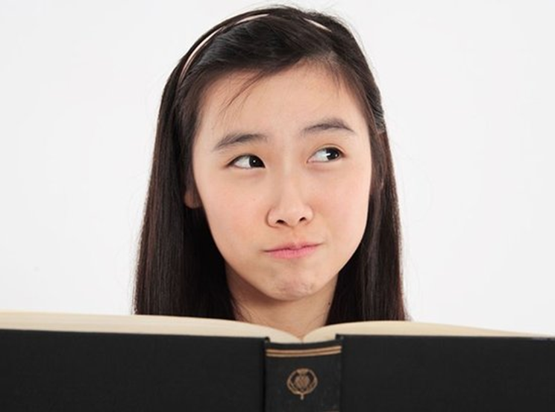
Word:_______squint_____________ Page Number (pg88) | Write the sentence in the book where you found the word: Cole squinted and made out little heads jutting above the nest
Write the Definition of the word in your words (Do not copy from the dictionary) If someone has a squint, their eyes look in different directions from each other
Words That Have the Same Meaning tend, affect |  | Words That have the Opposite meaning orthophoria | Picture/Symbol of the Meaning:

Slide 7
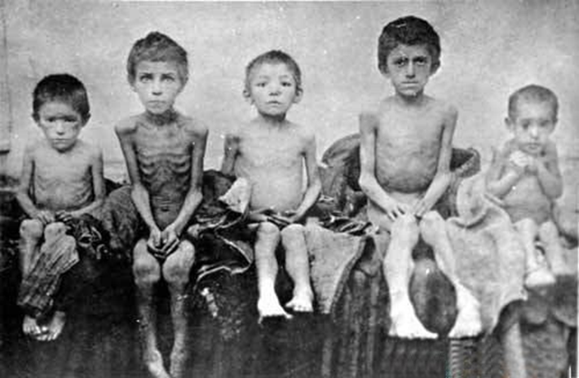
Word:______miserable______________ Page Number (pg88) | Write the sentence in the book where you found the word: Cole curse every second of his miserable and haphazard life.
Write the Definition of the word in your words (Do not copy from the dictionary) very unhappy; full of misery
Words That Have the Same Meaning Painful, |  | Words That have the Opposite meaning fortunate | Picture/Symbol of the Meaning:

Slide 8
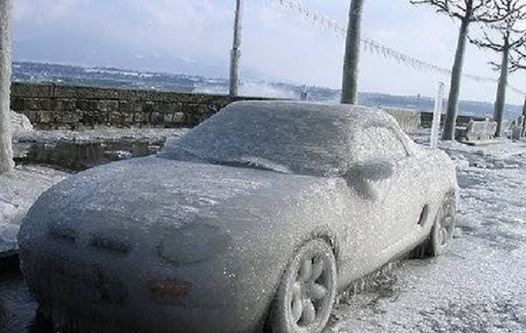
Word:_____frigid_______________ Page Number (pg89) | Write the sentence in the book where you found the word: His anger helped to focus his thoughts, but it could not stop the frigid drizzle of the torturing pain that wracked his body
Write the Definition of the word in your words (Do not copy from the dictionary) extremely cold
Words That Have the Same Meaning Freezing cold |  | Words That have the Opposite meaning warm | Picture/Symbol of the Meaning:

Slide 9
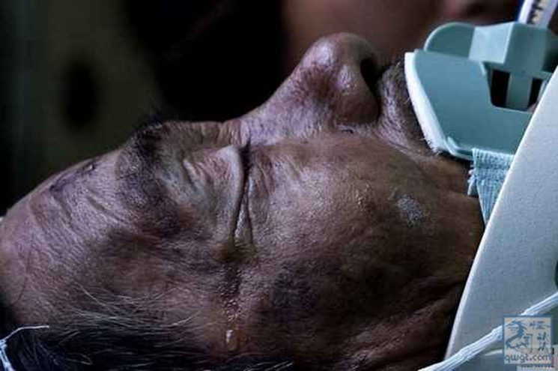
Word:____stuporous________________ Page Number (pg89) | Write the sentence in the book where you found the word: Exhaustion finally dragged him into a stuporous sleep
Write the Definition of the word in your words (Do not copy from the dictionary) stunned or confused and slow to react
Words That Have the Same Meaning insensible, unconscious |  | Words That have the Opposite meaning sober | Picture/Symbol of the Meaning:

Slide 10
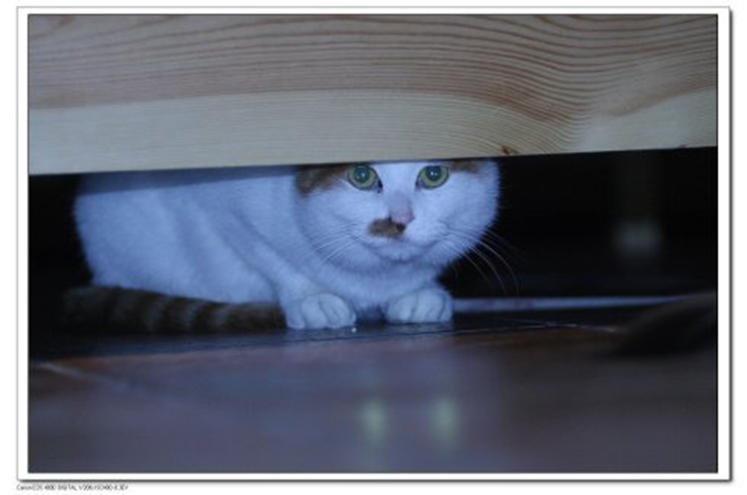
Word:__coward__________________ Page Number (pg90) | Write the sentence in the book where you found the word: Cole grimaced. He hated this bear. What a coward.
Write the Definition of the word in your words (Do not copy from the dictionary) a person who shows fear or timidity
Words That Have the Same Meaning molly |  | Words That have the Opposite meaning brave | Picture/Symbol of the Meaning:

